Slide 1

LINQ – Language Integrated Query in .NET
BE-3 CSE SEM 6
MANISH DAMOR - 8023058369 ROLL NO : 04

Slide 2
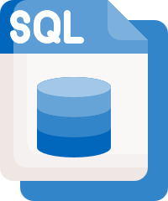
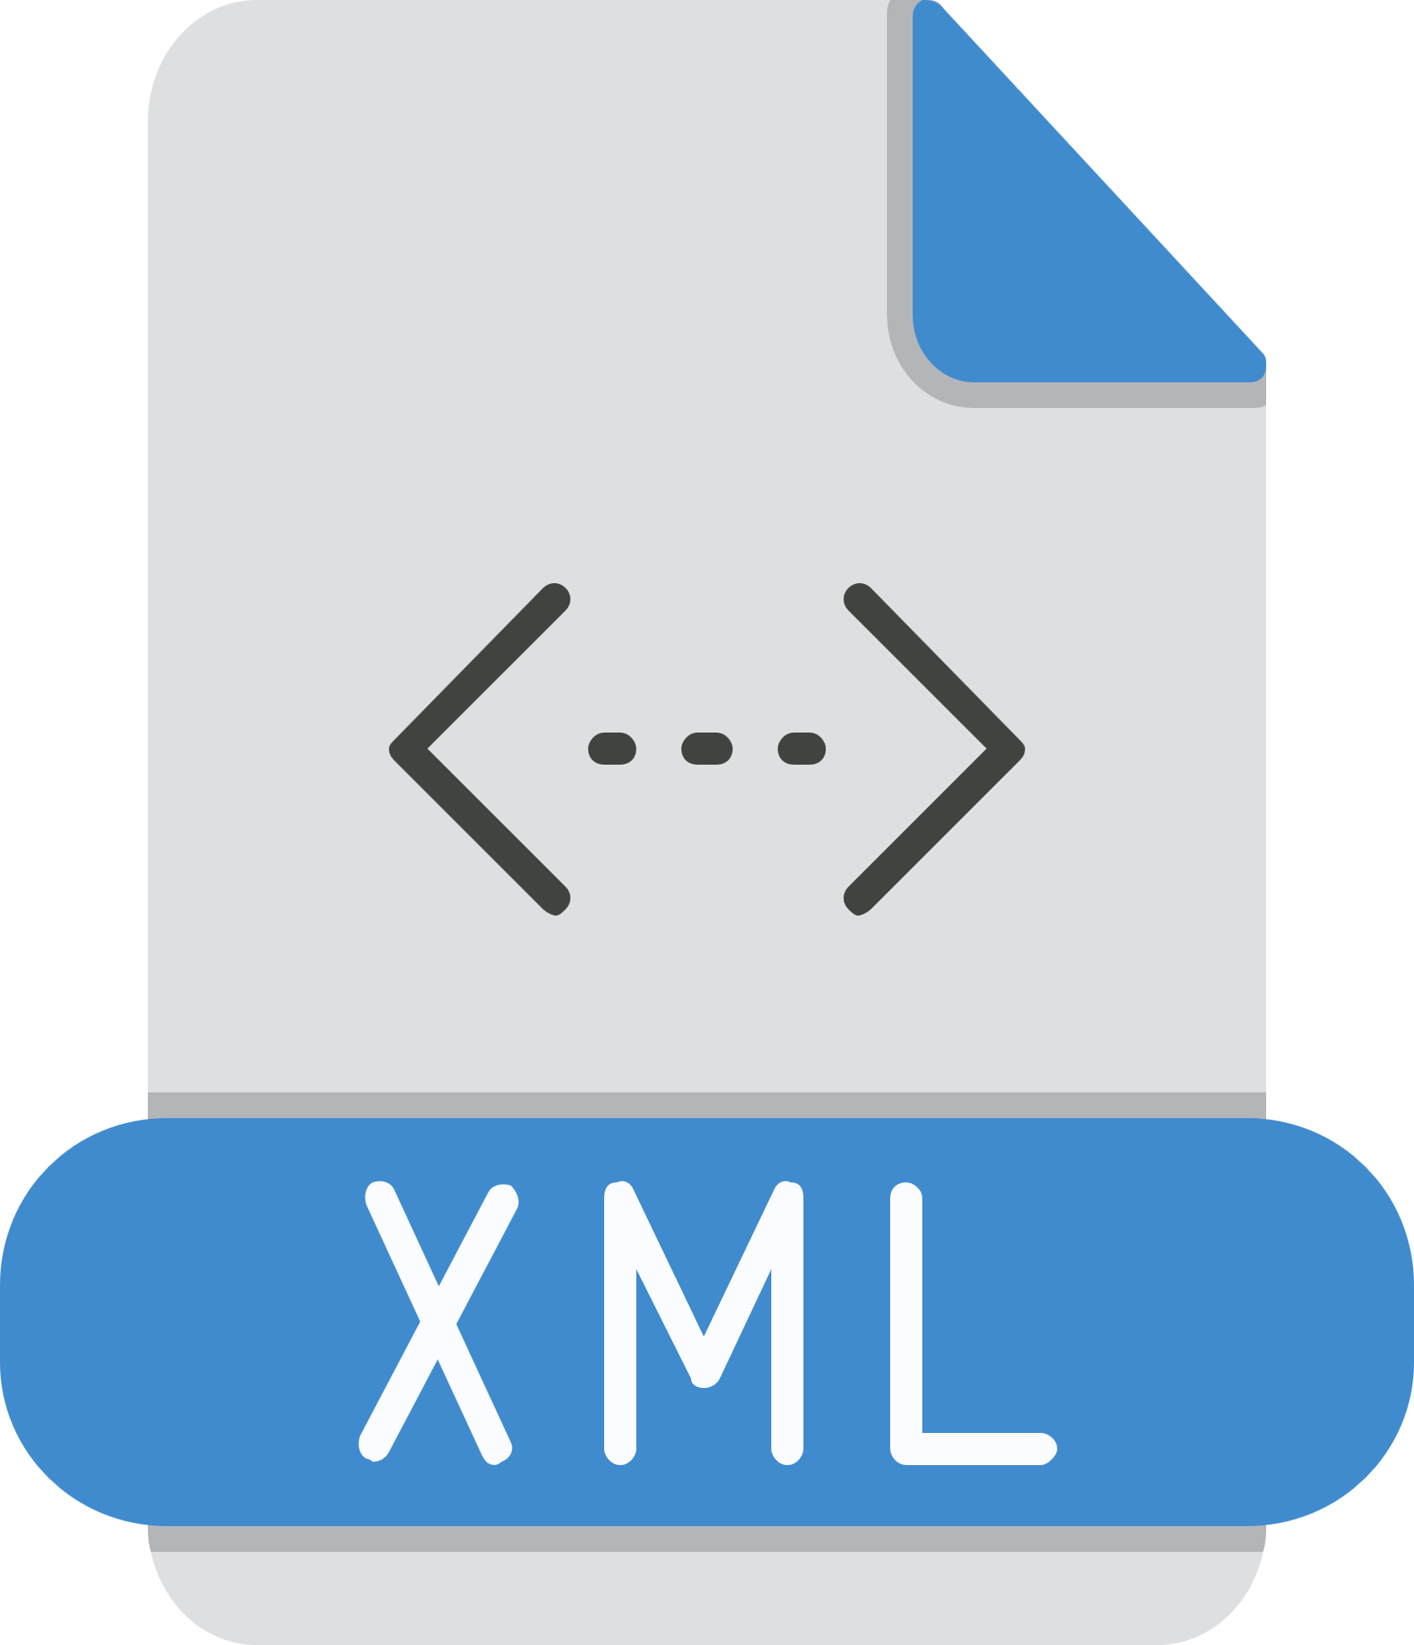

Introduction to LINQ
LINQ (Language Integrated Query) is a set of methods in .NET that allows querying data in a declarative way.
It simplifies querying collections, databases, XML, and other data sources using C#.
Introduced in .NET Framework 3.5 (2007).

Slide 3
Why Use LINQ?
Concise & Readable – Reduces boilerplate code
Type-Safety – Catches errors at compile-time
Intellisense Support – Works well with Visual Studio
Works with Different Data Sources – Supports Collections, Databases, XML, JSON
Improved Performance – Optimized querying

Slide 4
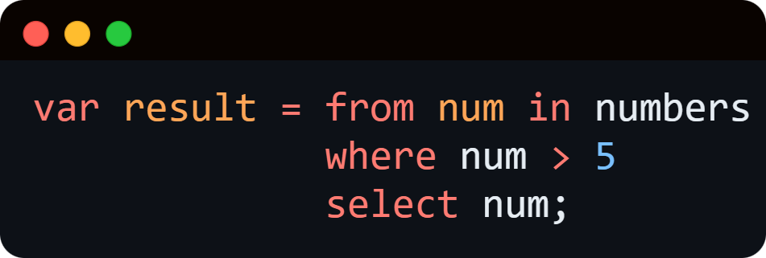
LINQ Syntax & Query Types
Query Syntax (SQL-like)

Slide 5
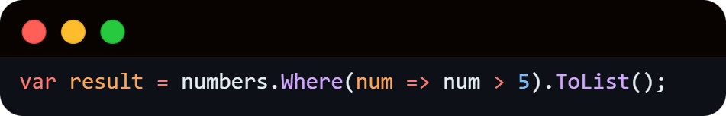
Method Syntax (Fluent API, recommended)

Slide 6
LINQ vs Traditional Loops
Feature | For Loop | LINQ
Code Length | Longer | Shorter
Readability | Complex | Simple
Performance | Faster for small data | Optimized for large data

Slide 7
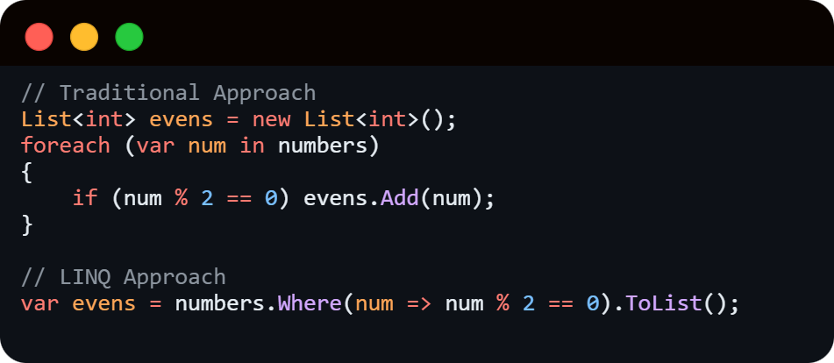

Slide 8
Common LINQ Methods

Slide 9
Most used LINQ methods in Method Syntax:
Select() – Project values
Where() – Filter records
OrderBy()/OrderByDescending() – Sort records
GroupBy() – Group similar records
Join() – Combine data from multiple sources
Aggregate() – Perform calculations

Slide 10
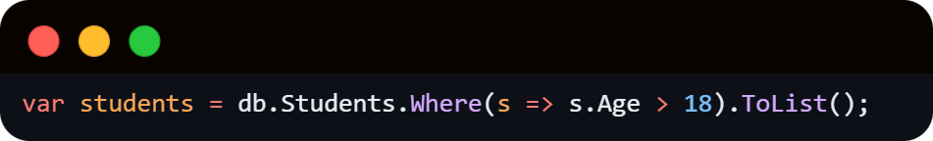
LINQ with Databases (Entity Framework)
LINQ is used in Entity Framework (EF) to query databases efficiently.
Example Query:

Slide 11
Benefits:
No need to write raw SQL
Works seamlessly with ORM (Object Relational Mapping)

Slide 12
Performance Considerations
Deferred Execution: Queries execute only when data is accessed.
Avoid multiple .ToList() calls (loads entire data in memory).
Use AsEnumerable() for in-memory filtering.

Slide 13
Real-World Use Cases
Querying lists of students/employees
Searching/filtering e-commerce products
Processing JSON or XML data
Reporting dashboards with aggregations
Data migration and transformation

Slide 14
Conclusion
LINQ simplifies data manipulation in C#.
Works with arrays, lists, databases, XML, JSON.
Query Syntax & Method Syntax – both have their use cases.
Entity Framework + LINQ = Powerful Database Queries.
Performance optimizations should be considered for large datasets.

